Slide 1
Blockchain & Smart Contract Attack Vectors
Jorden Seet

Slide 2
Who am I?
Jorden Seet
SMU, BSc Information Systems & Analytics double major
Blockchain Engineer at BMW Group
Blockchain Teaching Assistant for SMU
Passionate about Cybersecurity, from Pentesting to Cryptography to Network Topology
Recently completed an internship at Cyber Security Agency of Singapore (CSA)
Penetration Testing Department

Slide 3
Why am I here?
Blockchain is a buzzword
Foreign?
Unhackable?
It’s not that different!
Compilation of various attack vectors
Usually, presentations focus on a single scope
Take home something new
Smart Contract Attack Vectors
System Attack Vectors
Topology Attack Vectors

Slide 4
What is a Blockchain?

Slide 5
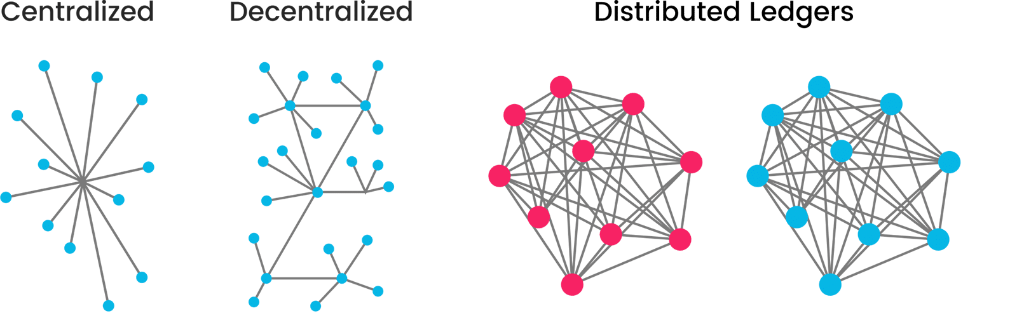
Blockchain is a special kind of Database
Permissioned
Permissionless

Slide 6
Blockchain is a Distributed Ledger
Permissioned
Permissionless

Slide 7
Benefits of Blockchain
Data Integrity
Consensus rejects nodes with inconsistent data
Requires “hacking” into 51% or 33% of nodes to carry attacks
High Availability
As long as one node is up, information is available
Hard to DDoS network when there is no single source
Distribution of bandwidth can also mitigate DDoS
High Auditability
Information in blockchain is transparent to all nodes in network
All information is linked to each other

Slide 8
Smart Contracts

Slide 9
What are Smart Contracts?
Cryptographic computer protocol that is designed to
Facilitate
Monitor
Verify
Enforce
The performance of an agreement in an immutable and exact manner.
Without third parties like
Lawyers
Auditors
Witnesses
Banks
Governments

Slide 10
Why do Smart Contracts need Blockchain?
Smart Contracts require witnesses
Honest nodes operating (anonymously) in a distributed network
Nodes may not necessarily be honest
Smart Contracts need a Byzantine Fault Tolerant environment
Consensus must be reached amidst failure of nodes
Ensured (to a higher degree) through the Blockchain

Slide 11
Smart Contract Attack Vectors

Slide 12
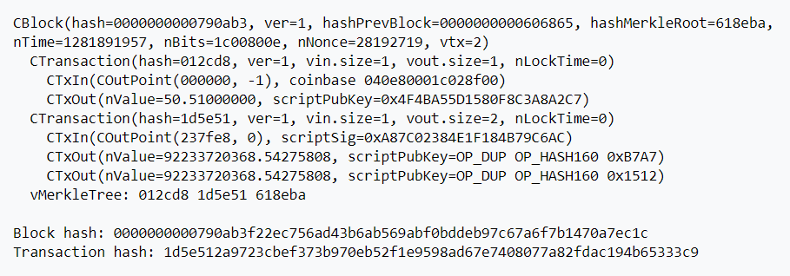
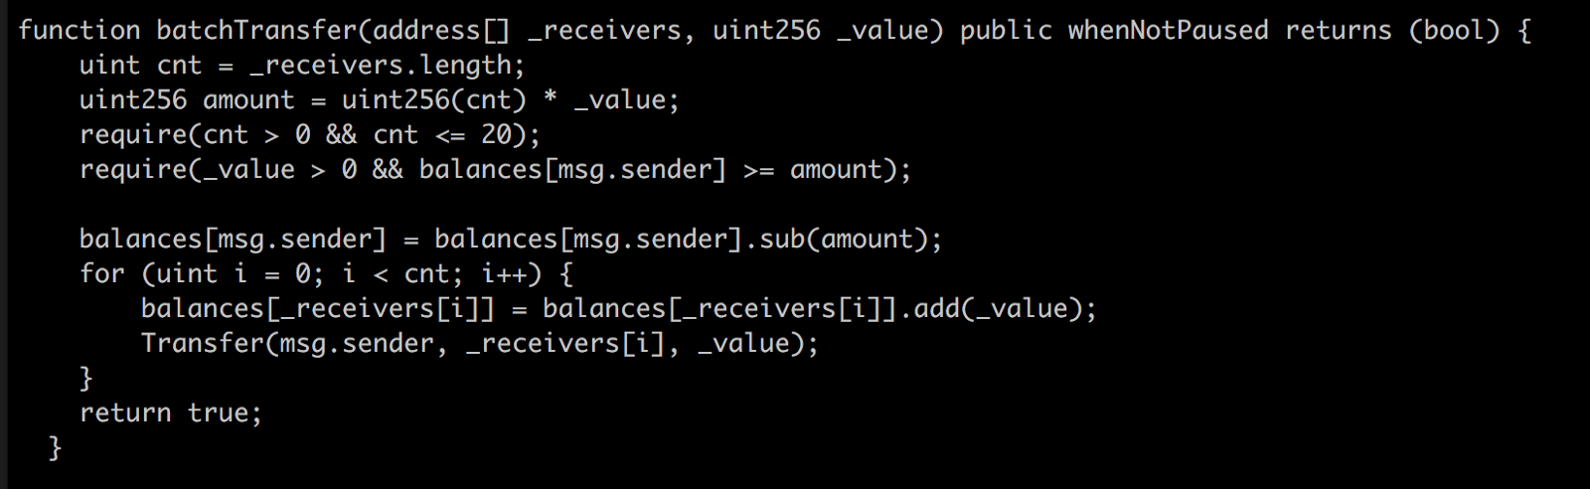
Integer Underflow/Overflow
When one puts in a value that exceeds the limit, the value becomes something else.
Uints have a max value of 2²⁵⁶ – 1, in Solidity it wraps after max value to 0
What happens if we call (2²⁵⁶ )/2 = 8*16^63
with 2 addresses?
92.2 Billion BTC each!
Notes:
Bitcoin Value Overflow
August 2010 → Blockchain eventually forked
Max BTC in circulation → 21 Million

Slide 13
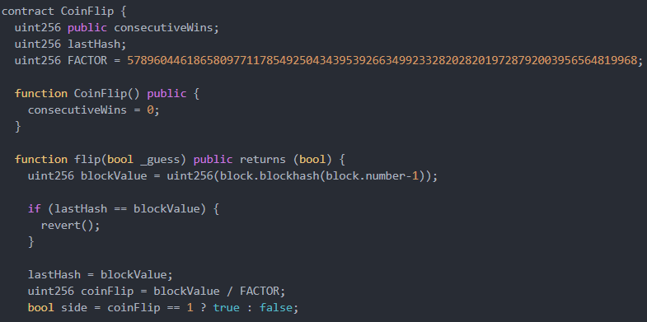
Timestamp Dependence
Dangerous to attempt pseudo-random number generation via block timestamps
Deterministic, attackers can determine the “random” variable

Slide 14
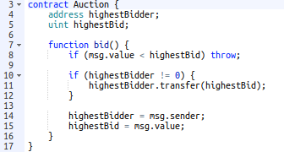
Denial of Service – Smart Contract level
Smart contracts can indicate if they are “payable”
Non-payable functions/contracts cannot receive cryptocurrency

Slide 15
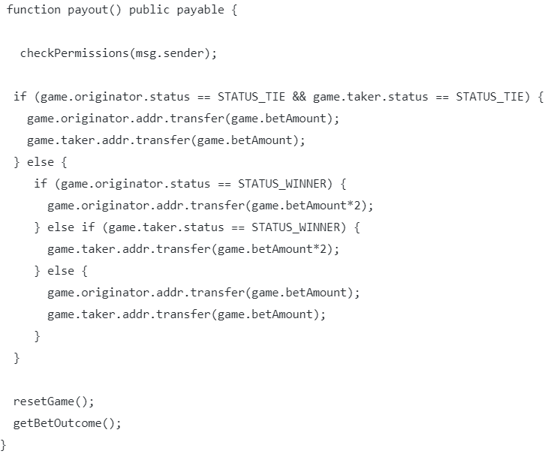
Reentrancy Attack
When a payment is made, it calls the fallback function of the payee contract
The fallback function can call the payment function again recursively
Notes:
Solution: Can set Boolean before transfer or deduct transferable amount from the msg.sender’s balance before the actual transfer
DAO hack →$60m
15% of all Ether

Slide 16
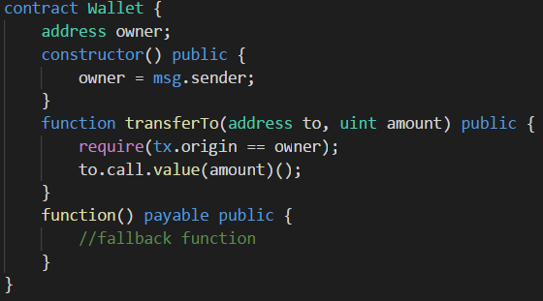
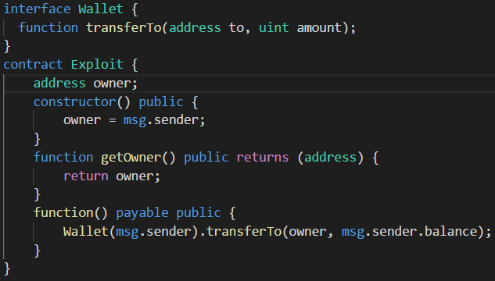
Phishing using tx.origin
Notes:
Wallet is created/used by another individual
Create Exploit contract
Trick victim to send a small amount of cryptocurrency to the Exploit Contract
Fallback function would be activated, and instantiates Wallet(victim)
Because tx.origin will be from the victim, the condition passes and it will send the entire balance of the Wallet to me

Slide 17
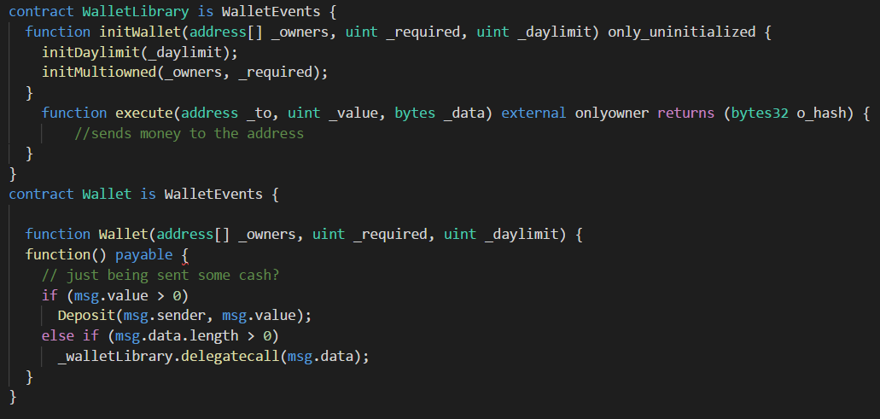
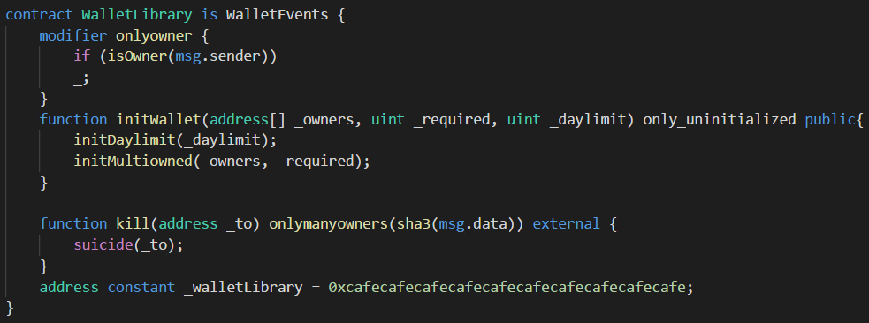
Parity Wallet attacks
Bad coding left them vulnerable to attacks on two occasions
Notes:
1st attack: $150m
2nd Attack: $31 million
In the first example, vulnerability is delegatecall, which gives full power of the contract to another person.
In this case, notice that the execute function has no require(), so anyone can call the execute function and send money
In the second example, people did not realise that the walletLibrary is technically a Wallet as well, and hence it was never initialized. So one person initWallet the library and killed it.

Slide 18
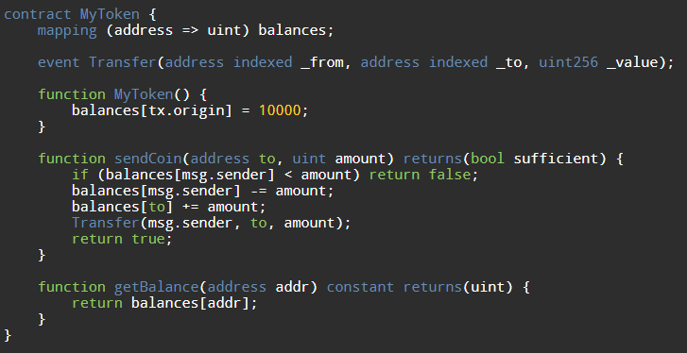
Short Address Attack
The fault here lies in the way EVM handles underflows, it pads it with 0s
00000000000000000000000062bec9abe373123b9b635b75608f94eb86441630
000000000000000000000000000000000000000000000000000000000000002
00000000000000000000000062bec9abe373123b9b635b75608f94eb8644163
0000000000000000000000000000000000000000000000000000000000000002
00000000000000000000000062bec9abe373123b9b635b75608f94eb86441630
0000000000000000000000000000000000000000000000000000000000000002
00000000000000000000000062bec9abe373123b9b635b75608f94eb86441630
0000000000000000000000000000000000000000000000000000000000000020
2<<4 = 32 coins
= 30 new coins
0x62bec9abe373123b9b635b75608f94eb86441630
2

Slide 19
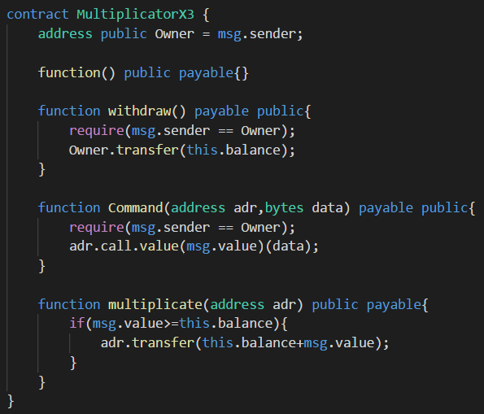
Honeypots
this.balance is updated before the multiplicate method is called
Hence, (msg.value>=this.balance) will always be false and transfer will not run (unless initial balance is 0)

Slide 20
Blockchain Attack Vectors
System Attack Vectors

Slide 21
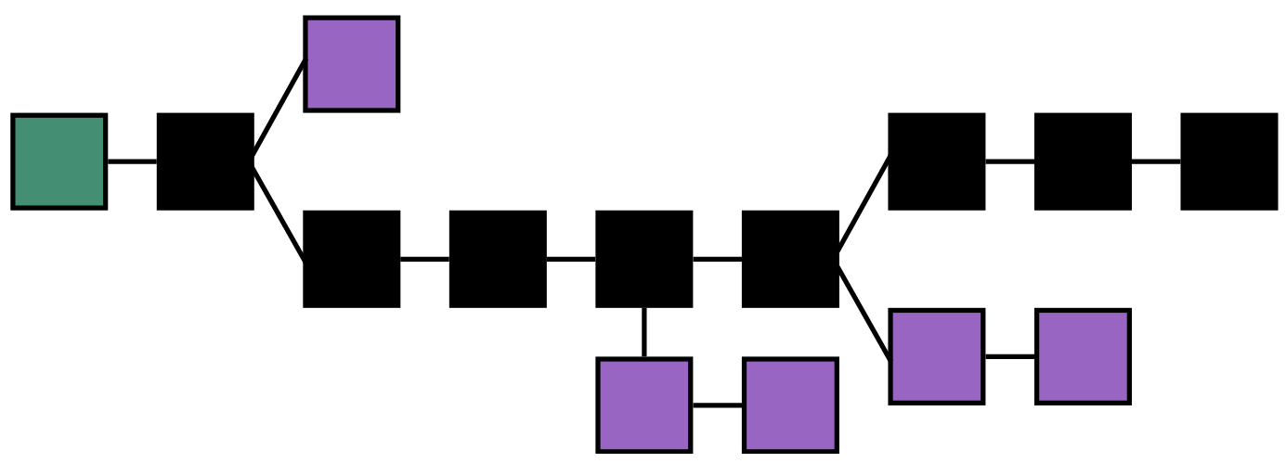
51% Attack (Proof of Work)
Blocks are validated through mining, which is dependent on hashing power

Slide 22
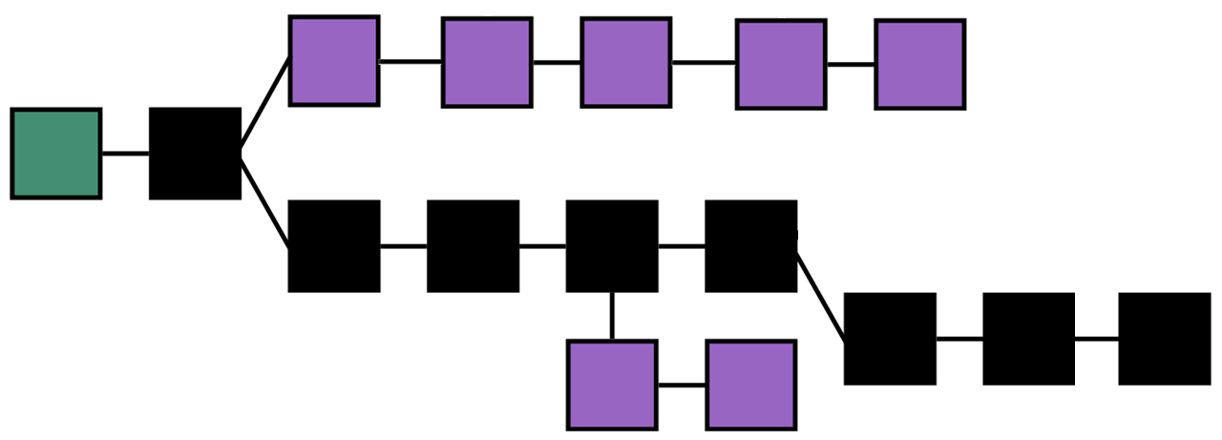
Long Range Attack (Proof of Stake)
Blocks are validated through validators, which is dependent on wealth (amount staked)
Notes:
Weak Subjectivity
Costless Simulation
Mitigation:
Longest Chain rule + moving checkpoints
Doesn’t cover short range attacks, but that’s a different story
Key-Evolving Cryptography
Prevent Posterior corruption
Context-aware Transactions
Prevent wholesale copying of transactions
Plenitude Rule
Block density of branch
Identifies fake branches fast

Slide 23
Transaction (sig) Malleability
Broadcasting the same transaction signature with a modified transaction hash
Sometimes, transaction signatures do not encompass all data in the transaction
Requires broadcast before confirmation of transaction into a valid block
Possible to malform transaction hashes by
Modifying minor details (whitespaces or paddings)
Using complementary signatures of certain cryptographic signature schemes (ECDSA)
Major transaction details like recipients and value remains unchanged
This transaction, if confirmed over the other original, will trick the sender to think the transaction failed when it actually succeeded
Senders query using their transaction signatures
Which is invalidated due to the modified, fraudulent transaction
Can lead to double-spending
Notes:
Attacker can wait for transactions to be made and quickly echo the transactions with modified data.
Network latency and other system factors gives this a real chance of happening.
Actually happened in the Mt Gox hack (or so they claimed), stealing 844,408 BTC (744,408 from customers, 100,00 from Mt Gox)
Solved with SegWit

Slide 24
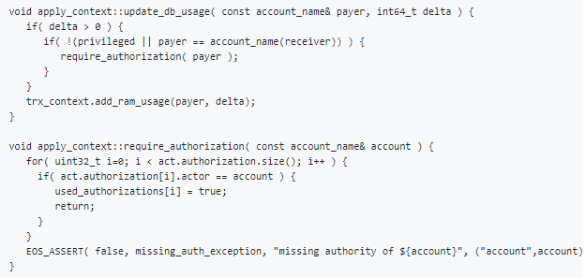
Denial of Service – System level
EOS RAM Hijack
EOS uses RAM to execute and store state of smart contracts
Smart contracts can notify others about specific events, such as token transfer
If recipient is a contract, does not check if action is authorized by action handler → RAM consumed
Can potentially fill action handler’s RAM with garbage notifications, thus using up all bandwidth to process contracts
Notes:
EOS RAM is a more complicated concept. It does not precisely correspond to the RAM concept in computer science. Simply put, it is all the resources used except CPU and bandwidth in EOS, roughly corresponding to RAM and database in computer science sense.

Slide 25
BFT Consensus algorithms forking
In BFT type algorithms, Blocks require 66% consensus on transaction validity
NEO Blockchain
Initially used a 2-phase protocol for efficiency and lower complexity
Missed the “commit” phase of traditional BFT algos
Uniformity of message “Proposed blocks” is not agreed upon
Led to different blocks formed on the blockchain → Fork
Caused ensuing blocks to record different previous hashes
Consensus cannot be agreed upon and stalled
Notes:
Solved by including 3rd phase “Commit”

Slide 26
TEE-based consensus
Proof of Elapsed Time (Intel’s Hyperledger Sawtooth)
Based on Intel Software Guard eXtensions (Intel SGX)
Utilises Trusted Execution Environments to generate randomness
Data is protected from even malicious or hacked kernels
Speculative Execution
Microarchitecturally, processor might speculatively guess values from memory
Faulty guesses disturbs other parts of the processor like the cache contents
Speculative Execution detects and measures such disturbances to infer in-memory values
Meltdown, Spectre, Foreshadow

Slide 27
Blockchain Attack Vectors
Topology Attack Vectors

Slide 28
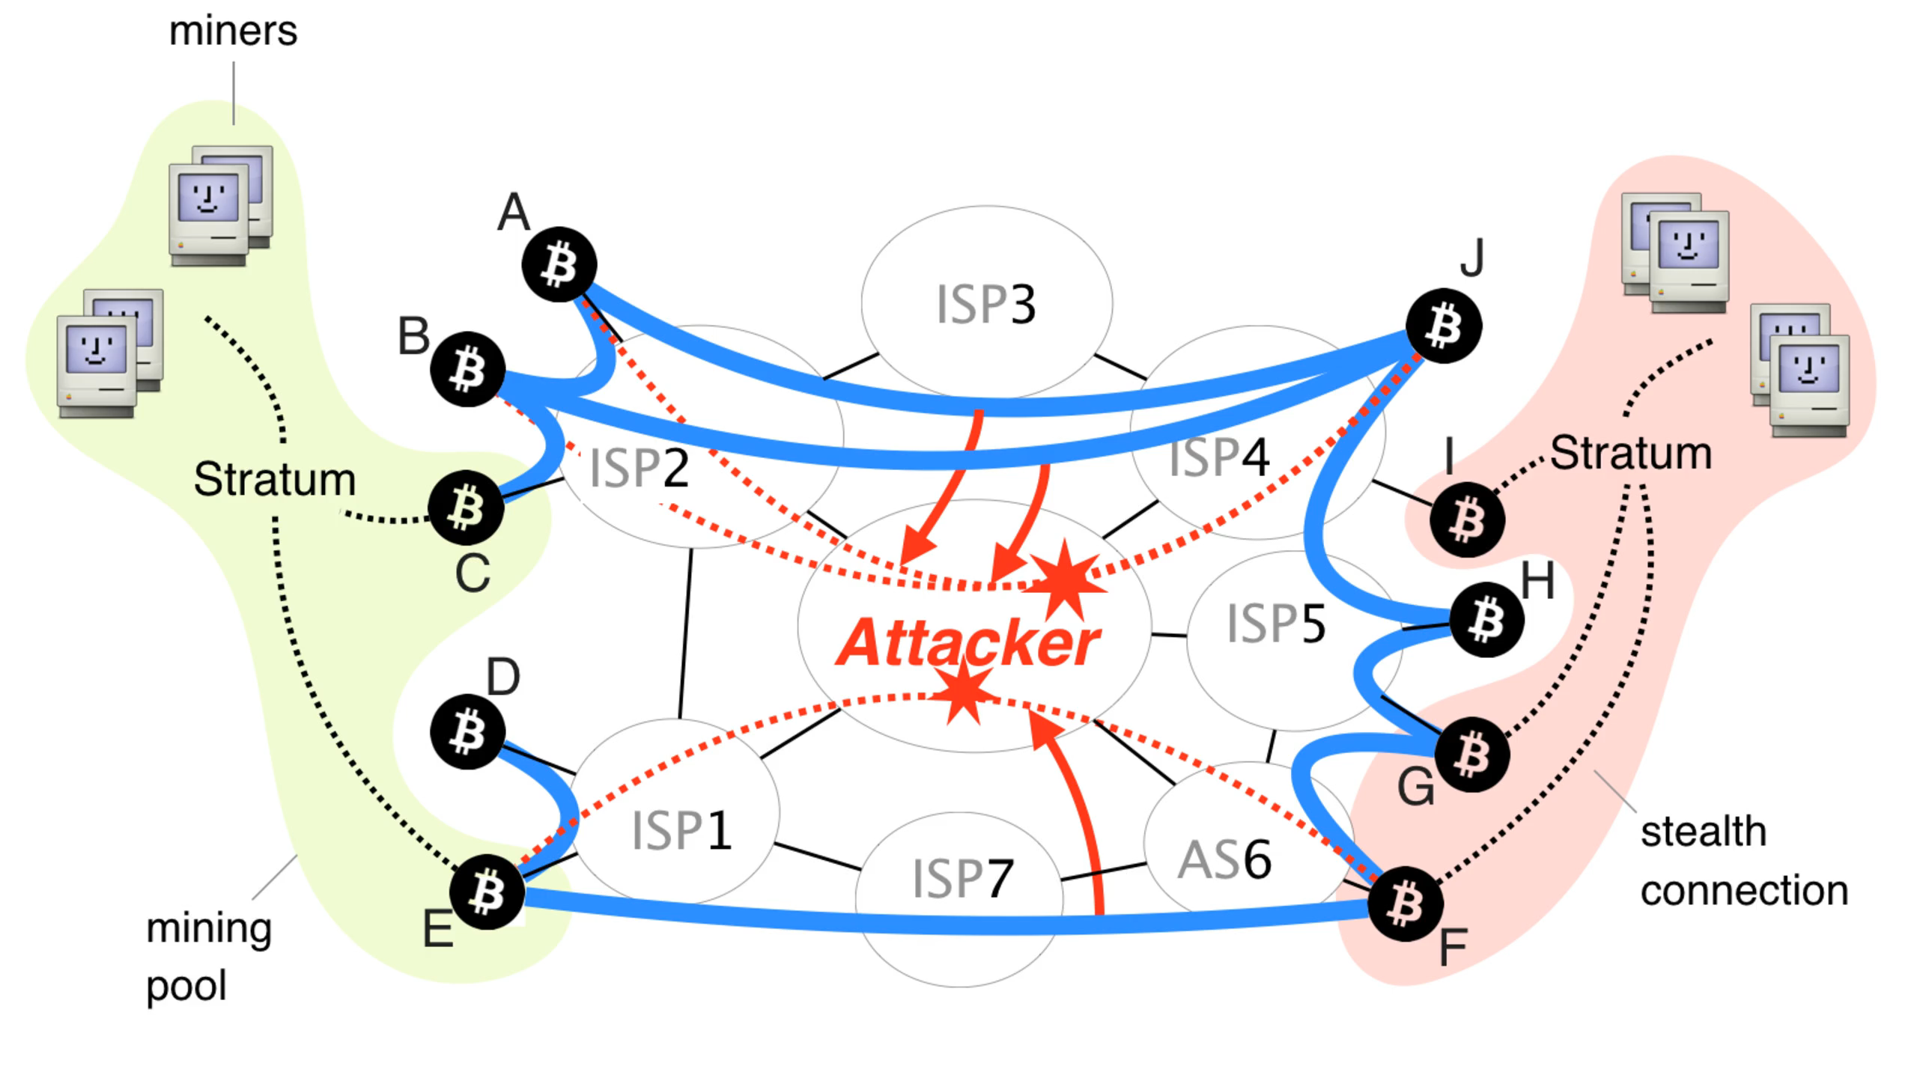
Partitioning Attack
Nodes are reliant on incoming communication from other nodes
Bitcoin has 8 connections, Ethereum has 13
If communication from nodes are malicious, can influence data recorded
If executed on large enough scale, can partition entire networks
Requires hijacking of Autonomous Systems (AS) or Border Gateway Protocol (BGP)
AS contains the information sent out
BGP determines the routing of information
Notes:
13 ISPs (0.026%) host 30% of BTC network
3 ISPs can view 60% of BTC traffic
By preventing nodes within a component to communicate with nodes outside of it, the attacker forces the creation of parallel blockchains. After the attack stops, all blocks mined within the smaller component will be discarded together with all included transactions and the miners revenue.
Step 0: Nodes of the left and the right side of the network communicate via Bitcoin connections denoted by blue lines.
Step 1: The attacker wishes to split the network into two disjoint components: one on the left hand-side and one on the right hand-side.
Step 2: The attacker attracts the traffic destined to the left nodes by performing a BGP hijack.
Step 3: Soon after the hijack, all traffic sent from the right to the left side is forwarded through the attacker (red lines).
Step 4: The attacker cuts these connections, effectively partitioning the network into two pieces.
Step 5: During the attack, nodes within each side continue communicating with nodes of the same side

Slide 29
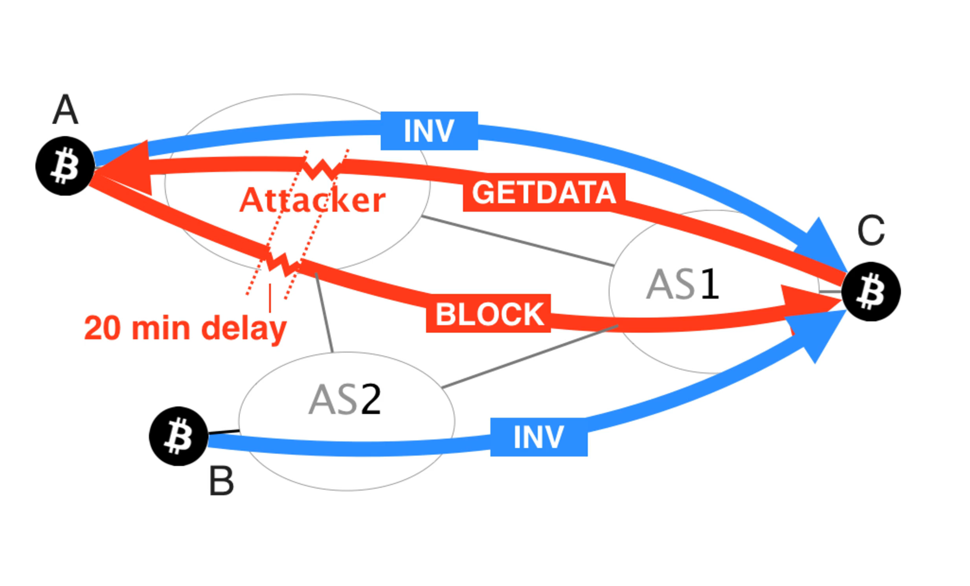
Delay Attack
Can delay delivery of block up to 20 minutes
Victim unaware of most recently mined block and its corresponding transactions
Double Spending attack
Wasteful mining
Notes:
Step 0: Nodes A and B advertise the same block to the victim, node C.
Step 1: Node C requests the block via a GETDATA from node A. The attacker changes the content of the GETDATA such that it triggers the delivery of an older block from node A.
Step 2: The older block is delivered.
Step 3: Shortly before 20 minutes after the original block request made by node C, the attacker triggers its delivery by modifying another GETDATA message originated by C.
Step 4: The block is delivered just before the 20 minutes timeout. The victim does not disconnect from node A.
Already affecting BTC network! In 2015 November, 8% (447 nodes) of all BTC nodes were hijacked. Now, at least 100 BTC nodes are victims of BGP hijacks per month.

Slide 30

Questions?

